Slide 1
Workshop: Introduction to Arduino
Setup Software! (Blink sketch)
Introductions
Goals of Tonight
Group Survey
Notes:
Introductions – Everyone introduces themselves
Goals of Tonight
Arduino, breadboarding, programming
Group Survey
Who knows what a breadboard is? Used one?
Who knows what a for loop is? Write one?

Slide 2
Safety
Shorting
Electricity is Dangerous

Slide 3
Possibilities
Inputs – sensors, buttons, joysticks, cameras
Outputs – motors, screens
https://www.youtube.com/watch?v=nZtfW2e2Cp0
Notes:
Explain components of video

Slide 4
Non-Code Example
A light switch in your house.
Notes:
Don’t relate to Arduino yet
Install Lightswitch
Install lightswitch
Install light
Lightswitch on means light on
Lightswitch off means light off

Slide 5
Circuit 1 Breadboarding
Parts
Arduino
Breadboard
Wires
LED
220 Ohm Resistor
Notes:
water on a waterfall, hit’s bottom has a lot of power, introduce wires, resistors
Wires
Go here, go there
220 Ohm Resistor
Resists
Water example
LEDs
- Polarity
- Current resistance
Breadboard
Explain how power flows
Arduino
Pins 1-13
Reset
Power (use waterfall example)
Data
Rest of pins – different ways to communicate

Slide 6
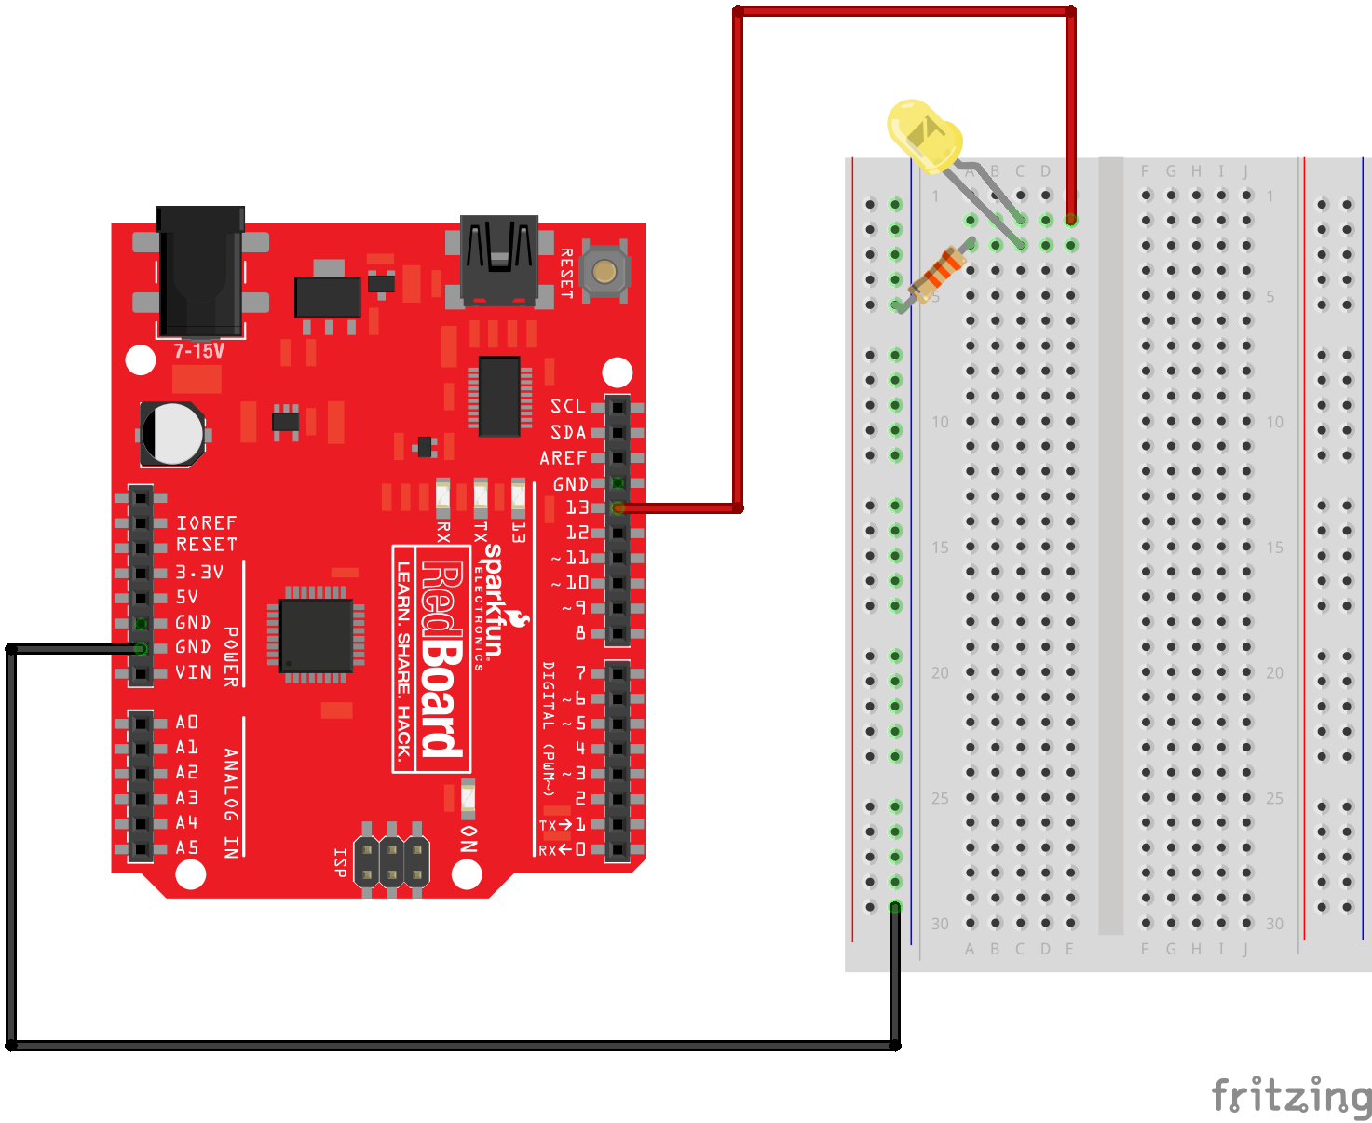

Slide 7
Circuit 1 Code
void setup() {
}
void loop() {
}
Notes:
Documentation
- Arduino website documentation
Arduino Software
New/File/Save etc
Examples
Great for testing ideas
Verify/Upload
Serial Monitor
Board
Port
Setup
- Runs once, initalizes the hardware for the rest of your code
Loop
- Runs forver until there is no power
{}
Tie back in to original non code example

Slide 8
Circuit 1 Code
/* This is a comment
that is two lines long */
// This is a setup
void setup() {
}
//This is a loop
void loop() {
}
Notes:
Comments
Multiline
Single line
It’s good practice to add comments to your code, maybe do so as we go

Slide 9
Circuit 1 Code
int myFirstLed = 13;
void setup() {
}
void loop() {
}
Notes:
Variable
Explain the types of variables. A string is letters, boolean is true/false, an integer
int value = number;
Explain int, value, =, number, ;
camelCase
-- helloWorld helloworld Helloworld hello_world

Slide 10
Circuit 1 Code
int myFirstLed = 13;
void setup() {
pinMode(myFirstLed, OUTPUT);
}
void loop() {
}
Notes:
pinMode(variable, INPUT)
Input, output
Input: something you receive information from
Ouptput: something you send information to
Input: keyboard, button
Output: Display something on a screen, turn a light on

Slide 11
Circuit 1 Code
int myFirstLed = 13;
void setup() {
pinMode(myFirstLed, OUTPUT);
}
void loop() {
digitalWrite(myFirstLed , HIGH);
}
Notes:
Input -> digitalRead()
Output -> digitalWrite()
High, Low (On, Off)
digitalWrite(myFirstLed,HIGH)
- Upload Sketch

Slide 12
Circuit 1 Code
int myFirstLed = 13;
void setup() {
pinMode(myFirstLed, OUTPUT);
}
void loop() {
digitalWrite(myFirstLed , HIGH);
delay(1000);
}
Notes:
Delay in ms

Slide 13
Circuit 1 Code
int myFirstLed = 13;
void setup() {
pinMode(myFirstLed, OUTPUT);
}
void loop() {
digitalWrite(myFirstLed , HIGH);
delay(1000);
digitalWrite(myFirstLed , LOW);
delay(1000)
}
Notes:
Talk about extra line:
ledBlinkRate = ledBlinkRate + 50;

Slide 14
Troubleshooting
Problems faced?
Notes:
Bring out the whiteboard and discuss problems
If no issues (ha ha)…
Raise hand
LED Direction
Shorts (burned out an LED)
Wiring breadboard
Resistance values
Is there power
Using a multimeter

Slide 15
Circuit 2: Breadboarding
Old Parts
Arduino
Breadboard
Wires
LED
Resistor
New Parts
Photoresistor
Notes:
Google: Photoresistor
Get good at google

Slide 16
Circuit 2: Learning about Photoresistor
Google: photoresistor arduino example
Notes:
Question: How do we wire up a photoresistor?
Steps
Read comments
Wire Up
Explain Serial
Copy previous example, switch pin for Arduino
Either move wire to new pin or change in sketch

Slide 17
Resources
Adafruit.com sparkfun.com arduino.cc microcenter.com https://circuits.io/

Slide 18
Going forward
Pick a project and jump in

